Slide 1

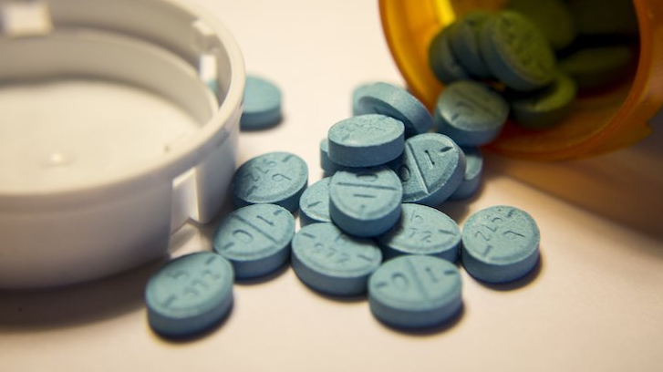

The Adderall EPIDEMIC
By: Sharn Singh

Slide 2
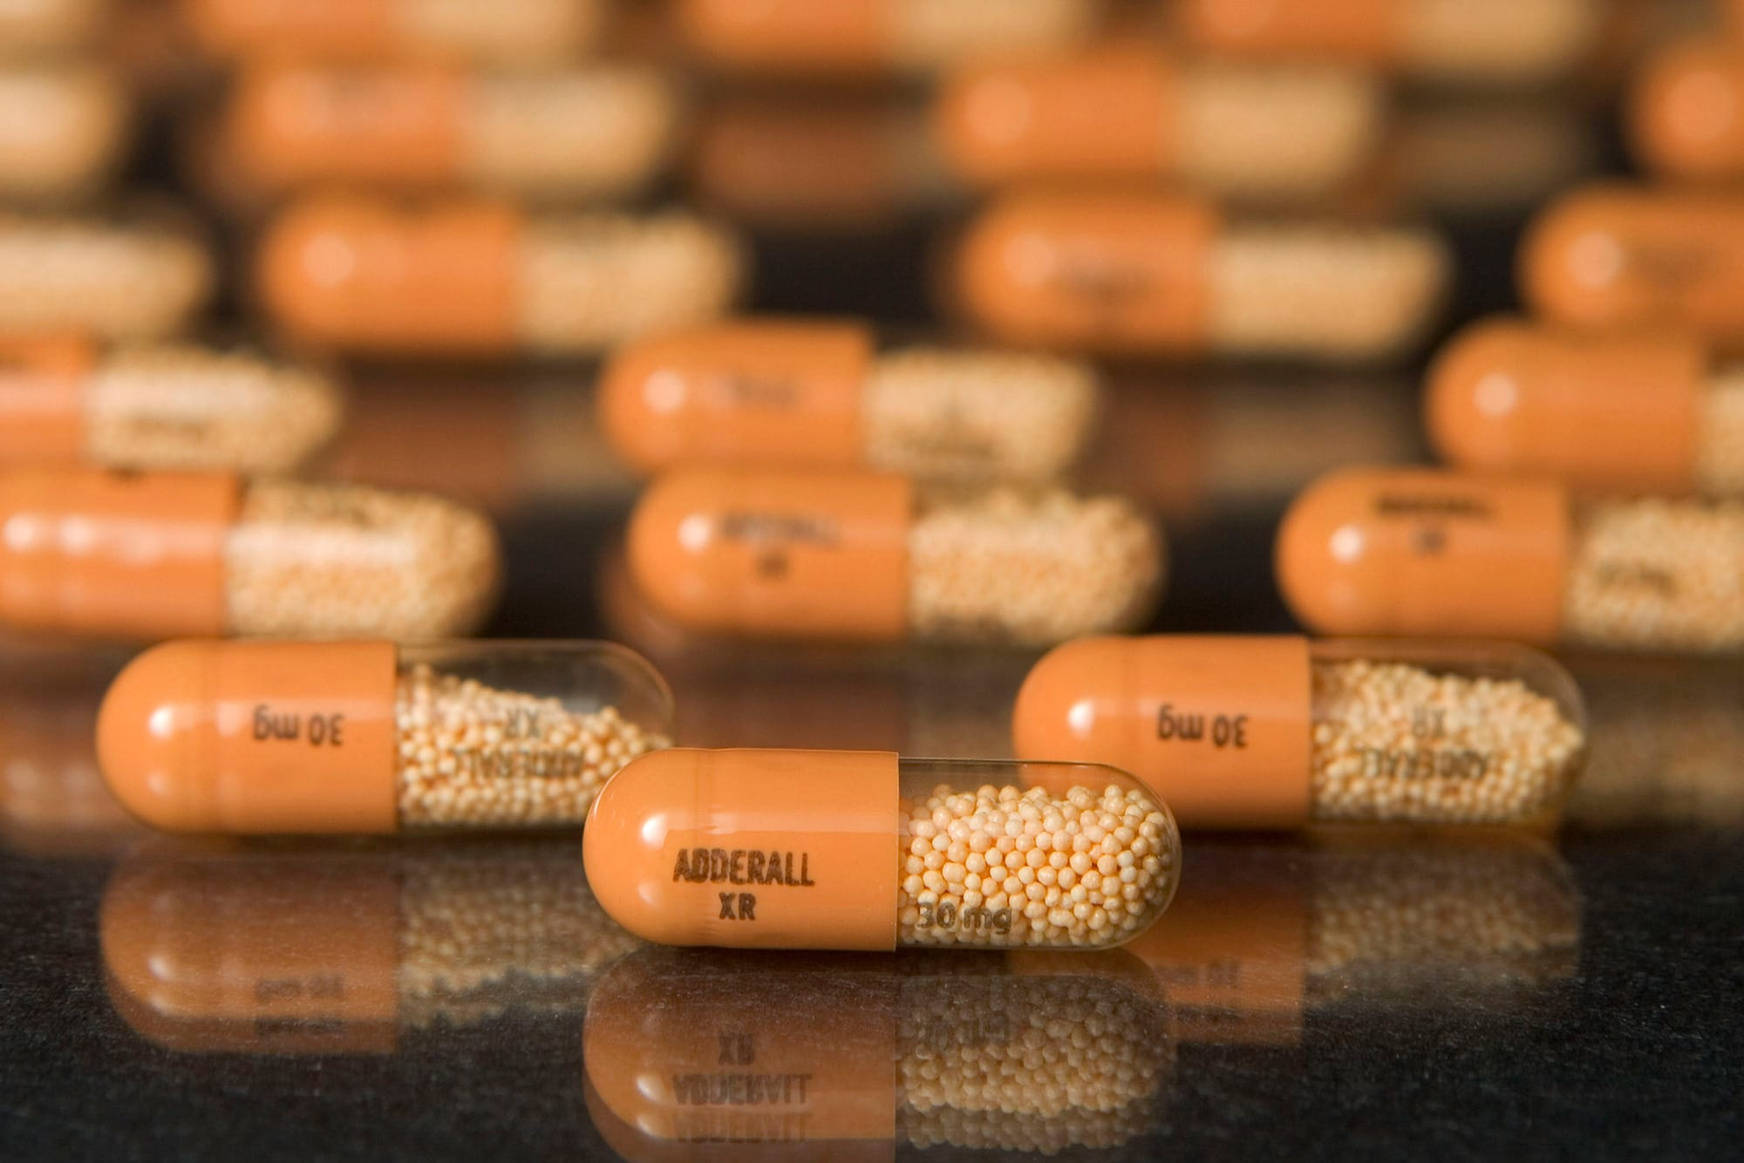
What is Adderall?
Adderall is a blend of amphetamine and dextroamphetamine, which are central nervous system stimulants. Consuming Adderall may help increment the ability to focus and control behavior.
Adderall mainly invigorates the sympathetic nervous system, which triggers the body's "fight or flight" reactions, such as pupil dilation and increased blood pressure.

Slide 3
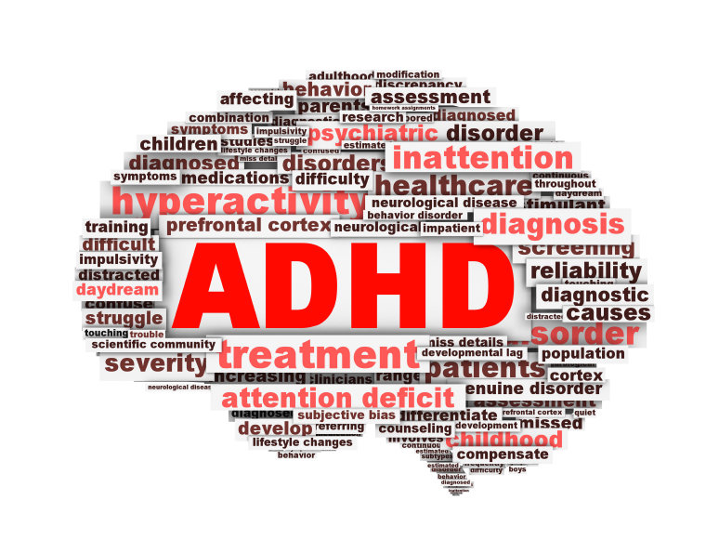
Adhd
ADHD represents attention deficit hyperactivity disorder. It is a medical condition. An individual with ADHD has contrasts in brain development that negatively affects attention, the ability to remain still, and self-control.
Adderall is viewed as a first-choice treatment choice for ADHD. Studies show that it improves attention and focus, and lessens imprudent behaviors. Between 75%-80% of individuals diagnosed with ADHD will see improved symptoms with the utilization of stimulants such as Adderall.

Slide 4

Adderall ABUSE
The fundamental cause for Adderall abuse is correlated to academics. Students state the medication helps them focus when they are studying or attempting to remain fixated on something.
Adderall has been classified as a Schedule II drug by the Drug Enforcement Administration. According to the DEA's website, Schedule II drugs are drugs with a high potential for abuse, with use possibly prompting extreme psychological or physical dependence. Other Schedule II drugs include methamphetamine, cocaine and oxycodone.
The magnitude of students taking Adderall for non-medical reasons is continuing to rise. Studies have demonstrated that the level of college students who report utilizing ADHD stimulants for nonmedical reasons ranges from 15% to 40%. It’s usually acquired through peers who possess prescriptions. Due to its addictive properties, the frequency of receiving the drug increases incrementally.

Slide 5
Major Side-Effects
Adderall is a strong stimulant that can prompt serious — and potentially deadly — side effects. Overdose is one the worst side effects of Adderall abuse, which can prompt heart attack, stroke and liver failure. It can likewise lead to nervousness, restlessness, and anxiety that impacts sleep patterns
Snorting Adderall is common among users searching for immediate effects. They crush the pills into a fine powder, sniffing Adderall into their sinus cavity. This enables the amplification of the stimulant’s side effects.

Slide 6
wORKs cITED
Stolz, Stefanie. “Chalk Talks- Adderall Abuse: Regulating the Academic Steroid.”Journal of Law and Education, Jefferson Law Book Company, 1 July 2017, www.questia.com/library/journal/1P3-2710555451/chalk-talks-adderall- abuse-regulating-the-academic.
“Controlled Substance Schedules.” Controlled Substance Schedules, 2019, www.deadiversion.usdoj.gov/schedules/.
“Attention-Deficit/Hyperactivity Disorder (ADHD): The Basics.” National Institute of Mental Health, U.S. Department of Health and Human Services, www.nimh.nih.gov/health/publications/attention-deficit-hyperactivity-disorder-adhd-the-basics/index.shtml.
“Adderall Oral : Uses, Side Effects, Interactions, Pictures, Warnings & Dosing.” WebMD, WebMD, www.webmd.com/drugs/2/drug-63163/adderall-oral/details.

